Slide 2
Topics
  Introduction
  Scene Graphs
  Using Scene Builder to Create JavaFX Applications
  Writing the Application Code
  RadioButtons and CheckBoxes
  Displaying Images

Slide 3
Introduction
JavaFX is a Java library for developing rich applications that employ graphics.
You can use it to create:
  GUI applications, as well as applications that display 2D and 3D graphics
  standalone graphics applications that run on your local computer
  applications that run from a remote server
  applications that are embedded in a Web page

Slide 4
Introduction
A GUI (pronounced “gooey”) is a graphical window or a system of graphical windows presented by an application for interaction with the user.
In addition to accepting input from the keyboard, GUIs typically accept input from a mouse, or a touch screen.

Slide 5
Introduction
A window in a GUI commonly consists of several components that present data to the user and/or allow interaction with the application.
Some of the common GUI components are buttons, labels, text fields, check boxes, and radio buttons.

Slide 6
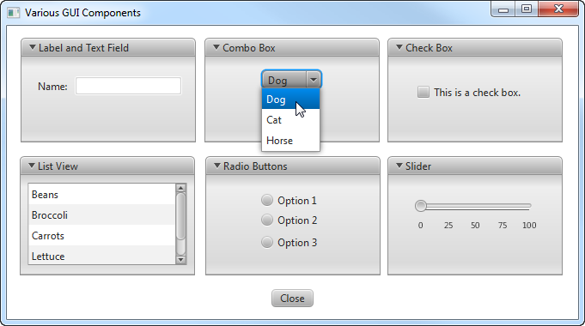
Various GUI Components

Slide 7
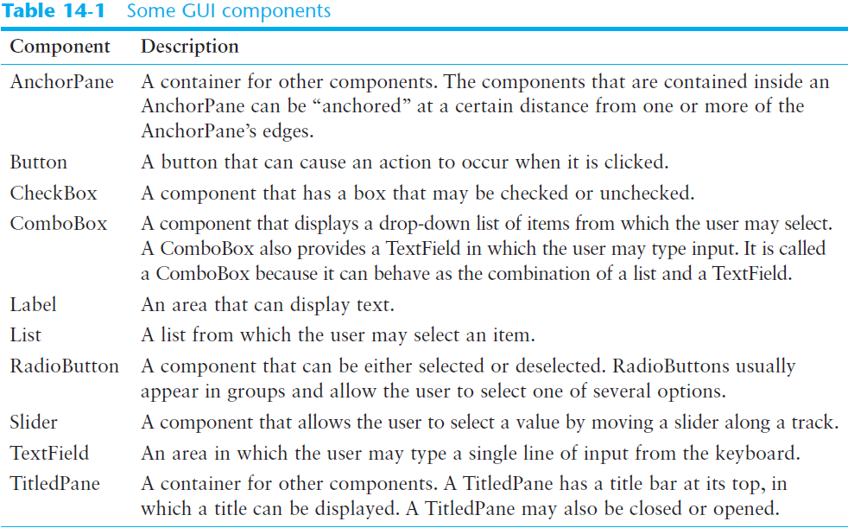

Slide 8
Event-Driven Programming
Programs that operate in a GUI environment must be event-driven.
An event is an action that takes place within a program, such as the clicking of a button.
Part of writing a GUI application is creating event listeners.
An event listener is a method that automatically executes when a specific event occurs.

Slide 9
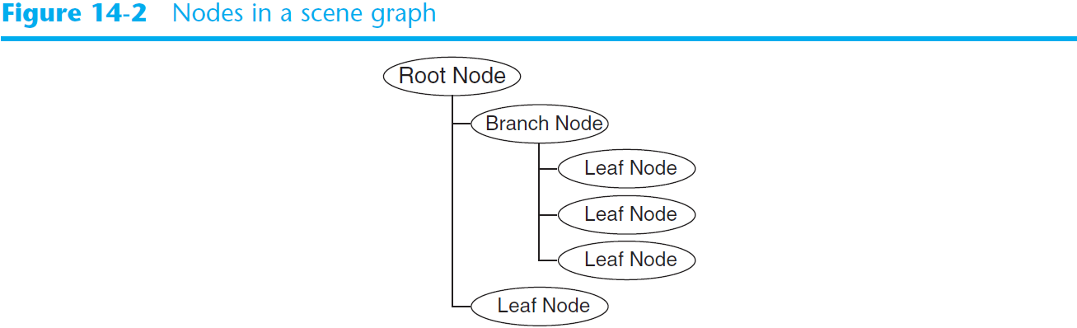
Scene Graphs
In JavaFX, the components that are in a GUI are organized as a scene graph.
A scene graph is a tree-like, hierarchical data structure that contains nodes.

Slide 10
Scene Graphs
A scene graph can have three types of nodes:
  Root Node:
    The scene graph can have only one root node.
    It is the parent of all the other nodes in the scene graph.
    It is the first node in the structure.
  Branch Node:
    A branch node can have other nodes as children.
  Leaf Node:
    A leaf node cannot have children.
In a nutshell, the root node and branch nodes can have children, but leaf nodes cannot.

Slide 11
Scene Graphs
In JavaFX, a node that can have children is a container.
A container is a component that can hold other components inside of it.
The JavaFX library provides several different types of containers.

Slide 12
Scene Graphs
The AnchorPane container is commonly used as a GUI’s root node.
A branch node is a container that is placed inside the root node or inside another branch node.
  For example, you might have a Pane (one of the simplest JavaFX containers) inside of an AnchorPane.
A leaf node is a component that is not a container.
  For example, Button components and Label components are leaf nodes.

Slide 13
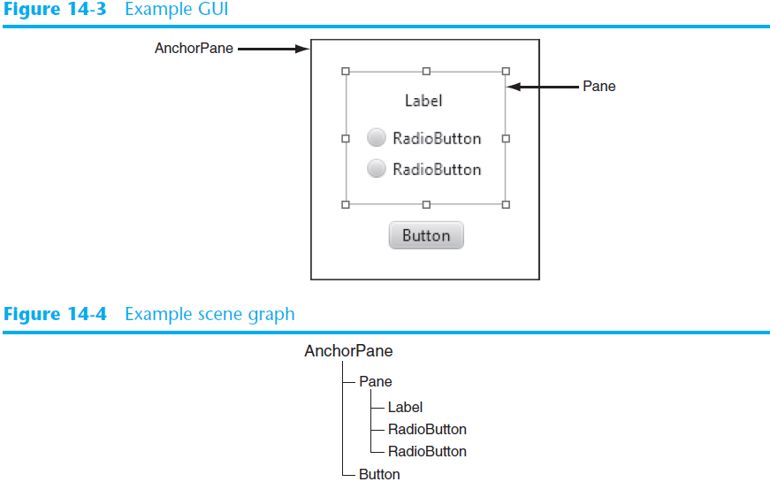
The Anchor Pane is the root node
The Pane is a branch node
The Button, Label, and Radio button components are leaf nodes
Root Node
Branch Node
Leaf Nodes

Slide 14
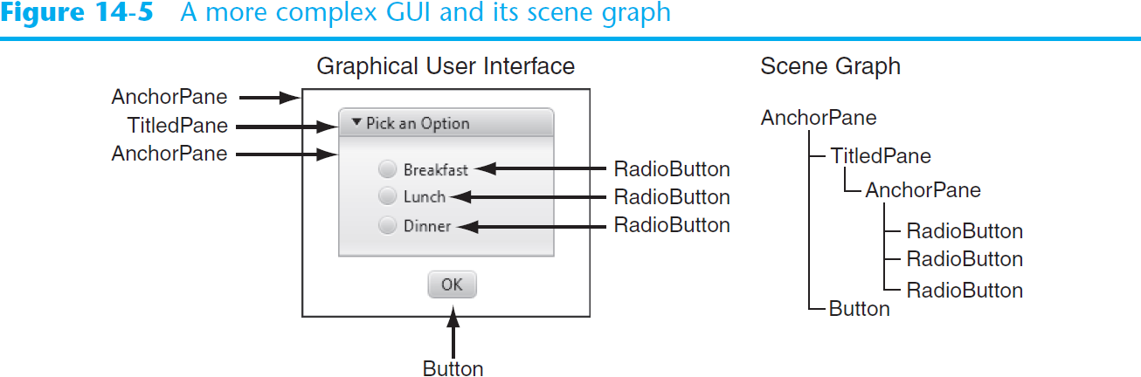
The AnchorPane is the root node
  The TitledPane is a child of the AnchorPane
  it is contained inside the AnchorPane
    Another AnchorPane is a child of the TitledPane
    it is contained inside the TitledPane
    The Three RadioButtons are children of the innermost AnchorPane
  The Button is a child of the root node AnchorPane.

Slide 15
Using Scene Builder to Create JavaFX Applications
Scene Builder is a free design tool from Oracle for visually creating GUIs.
It works like this:
  Use Scene Builder to construct a GUI by dragging and dropping the components that you need onto a blank window.
  Visually arrange the components on the window and set various component properties to create the appearance that you want for the GUI.
  Save the GUI to an FXML file.
FXML is a markup language that describes the components in a JavaFX scene graph.
FXML uses tags to organize data, in a manner similar to the way that HTML uses tags to format text in a Web browser.

Slide 16
Using Scene Builder to Create JavaFX Applications
Visually creating a GUI with Scene Builder is only part of the process.
Once you save a GUI’s scene graph to an FXML file, the next step is to write Java code that reads the FXML file and displays the GUI on the screen and handles any events that occur while the application is running.

Slide 17
Starting Scene Builder
You can download Scene Builder from the following location:
www.oracle.com/technetwork/java/javafx/downloads/
When you install Scene Builder in Windows, a shortcut is automatically created on the desktop.
You can launch Scene Builder either by double-clicking the shortcut, or by going to All Programs > JavaFX Scene Builder and clicking JavaFX Scene Builder x.x
  where x.x will be a version number such as 1.1 or 2.0
If you installed Scene Builder on a Mac, go to the Applications folder and double-click the shortcut for JavaFX Scene Builder x.x
  where x.x will be a version number such as 1.1 or 2.0

Slide 18
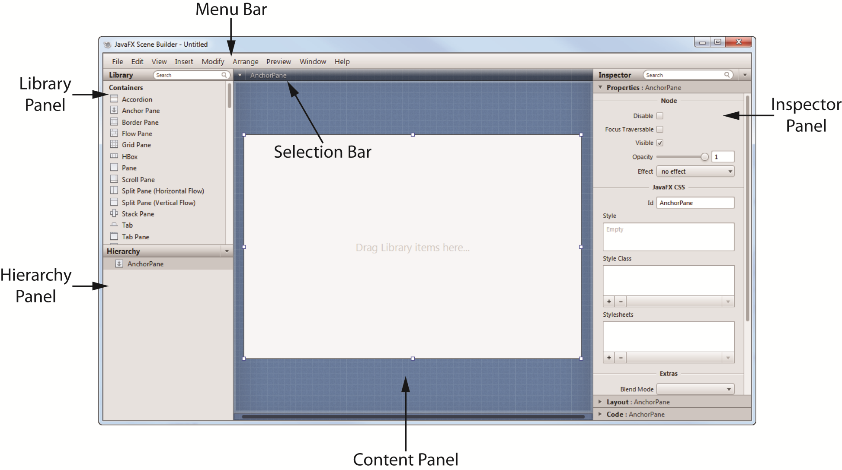
The Scene Builder Main Window

Slide 19
The Scene Builder Main Window
Here is a brief summary of each part of the main window:
Menu Bar
  Scene Builder’s commands are located on the menus that access the menu bar at the top of the main window.

Slide 20
The Scene Builder Main Window
Library Panel
  The Library Panel provides a list of JavaFX components that you can use in an application.
  To place a component in a GUI, you simply drag it from the Library Panel, and drop it into the Content Panel.

Slide 21
The Scene Builder Main Window
Content Panel
  The Content Panel is where you visually design an application’s GUI.
  It initially shows an AnchorPane as the GUI’s root node.
  You create other components in the GUI by dragging them from the Library Panel and dropping them onto the root node component..

Slide 22
The Scene Builder Main Window
Hierarchy Panel
  The Hierarchy Panel shows the GUI’s scene graph.
  As you add components to the Content Panel, nodes appear in the Hierarchy Panel.
  You can use the Hierarchy Panel to select nodes that you want to edit.

Slide 23
The Scene Builder Main Window
Selection Bar
  This area of the screen shows the hierarchical path of the currently selected node in the scene graph.

Slide 24
The Scene Builder Main Window
Inspector Panel
  The Inspector Panel is divided into three sections:
    Properties
    Layout
    Code

Slide 25
The Scene Builder Main Window
The Properties section
  allows you to view and edit the values of the selected component’s properties, which are values that determine the component’s appearance.
The Layout section
  lets you specify values that control the way the component is displayed when the GUI’s window is resized.
The Code section
  allows you to assign an fx:id to a component, which is similar to assigning a variable name to the component.
  also allows you to designate event handlers to execute when specific events happen to the selected component.

Slide 26
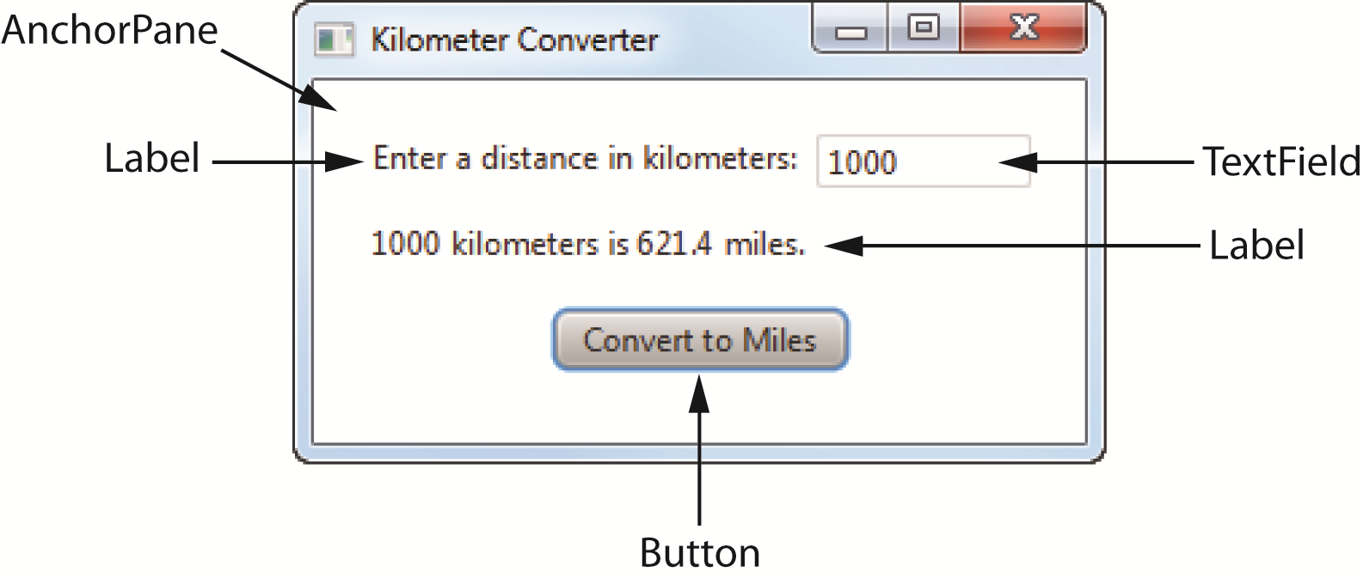
Using Scene Builder to Create the Kilometer Converter GUI
An AnchorPane, as the root node
A Label to display the prompt Enter a distance in kilometers:
A TextField in which the user will enter a distance
A Label to display a message showing the distance converted to miles
A Button that performs the conversion

Slide 27
Writing the Application Code
Once you have saved an application’s GUI to an FXML file, you can write the Java code that runs the application.
A simple JavaFX application uses:
  a main application class
  a controller class

Slide 28
The Main Application Class
Once you have created a GUI with Scene Builder, and saved it to an FXML file, you need to write a Java class that performs the following:
  Loads the FXML file
  Builds the scene graph in memory
  Displays the GUI
Example: KilometerCoverter.java

Slide 29
The Controller Class
The controller class is responsible for handling events that occur while the application is running.
The controller class contains the following items:
  The necessary import statements
  Private variables to reference the components that have a fx:id in the scene graph
  An initialize method that is automatically called after the FXML file is loaded
  Event listener methods
Example: KilometerCoverterController.java

Slide 30
Using the Sample Controller Skeleton
An alternative for manually typing the code for the controller class, Scene Builder can provide a sample "skeleton" for the controller class.
To see the sample controller skeleton, click the View menu, then click Show Sample Controller Skeleton
You can click the Copy button to copy the sample code to the clipboard, and then paste it into an editing window in your IDE.
The obvious benefit of using the sample skeleton controller is that a lot of the code is written for you.
The skeleton has all of the necessary import statements, and the class already has private field declarations for all of the components that have an fx:id.
You just need to change the name of the class, and write the code for the event listener methods.

Slide 31
Summary of Creating a JavaFX Application
Use Scene Builder to design the GUI. Be sure to give an fx:id to all of the components that you plan to access in your Java code. Save the GUI as an FXML file.
Write the code for the main application class, which loads the FXML file and launches the application. Save and compile the code in the same location as the FXML file.
Write the code for the controller class, which contains the event handler methods for the GUI. Save and compile the code in the same location as the FXML file.
In Scene Builder, register the controller class, then register an event handler method for each component that needs to respond to events. Save the FXML file again.

Slide 32
RadioButtons and CheckBoxes
RadioButtons normally appear in groups of two or more and allow the user to select one of several possible options.
CheckBoxes, which may appear alone or in groups, allow the user to make yes/no or on/off selections.

Slide 33
RadioButtons
RadioButtons are useful when you want the user to select one choice from several possible options.
A radio button may be selected or deselected.
Each radio button has a small circle that appears filled-in when the radio button is selected and appears empty when the radio button is deselected.

Slide 34
Creating a RadioButton
To create a RadioButton, you simply drag it from the Library panel and drop it onto the Content panel.
(The RadioButton component is found in the Controls section of the Library panel.)
RadioButtons have a Text property that determines the text they display.
RadioButtons normally are in a toggle group.

Slide 35
Adding RadioButtons to a Toggle Group
Here are the steps for adding RadioButtons to a toggle group:
  Create the first RadioButton component in the Content panel.
  Open the Properties section of the Inspector Panel, and find the Toggle Group property.
  Enter the name you wish to give the toggle group.
  Create the next RadioButton.
  For its Toggle Group property, you should be able to click the down-arrow and select the toggle group that you created for the first RadioButton.
  Repeat this for each subsequent RadioButton that you want in the same toggle group.

Slide 36
Determining in Code Whether a RadioButton Is Selected
In the controller class, you can use the RadioButton's isSelected method to determine whether the RadioButton is selected or not.
The isSelected method returns a boolean value.
  If the RadioButton is selected, the method returns true . Otherwise, it returns false .
Example: RadioButtonDemo.java, RadioButtonDemoController.java
if (radio.isSelected())
{
// Code here executes if the radio
// button is selected.
}

Slide 37
Responding to RadioButton Events
In many situations you want an action to take place at the time the user clicks a RadioButton.
  you must write an event listener method in the controller class for each RadioButton
  and then select the appropriate method as the event listener in Scene Builder.
Example: RadioButtonEvent.java, RadioButtonEventController.java

Slide 38
CheckBoxes
A CheckBox is a small box with text appearing next to it.
Like RadioButtons, CheckBoxes may be selected or deselected at run time.
When a CheckBox is selected, a small check mark appears inside the box.
Although CheckBoxes are often displayed in groups, they are not usually grouped in a toggle group like RadioButtons are.

Slide 39
Creating a CheckBox
To create a CheckBox, you simply drag it from the Library panel and drop it onto the Content panel.
(The CheckBox component is found in the Controls section of the Library panel.)
CheckBoxes have a Text property that determines the text they display.

Slide 40
Determining in Code Whether a CheckBox Is Selected
In the controller class, you can use the CheckBox’s isSelected method to determine whether the CheckBox is selected or not.
The isSelected method returns a boolean value.
  If the CheckBox is selected, the method returns true . Otherwise, it returns false .
Example: CheckBoxDemo.java, CheckBoxDemoController.java
if (checkbox.isSelected())
{
// Code here executes if the
// CheckBox is selected.
}

Slide 41
Responding to CheckBox Events
Sometimes you want an action to take place at the time the user clicks a CheckBox.
  you must write an event listener method in the controller class for the CheckBox
  and then select the method as the event listener in Scene Builder.
Example: CheckBoxEvent.java, CheckBoxEventController.java

Slide 42
Displaying Images
You can use the ImageView component to display images in an application's GUI.
You simply drag the component from the Library panel (you will find it in the Controls section) and drop it onto the Content Panel
Once you have created a ImageView component, you use its Image property to specify the image that it will display.

Slide 43
Displaying an Image with Code
Sometimes you might need to write code that will change the image being displayed in an ImageView component, as the application is running.
In your controller class, you can call the ImageView component's setImage method to do this.

Slide 44
Displaying an Image with Code
First, you must create an instance of the Image class, which can read the contents of an image file.
The Image class is in the javafx.scene.image package.
The Image class constructor accepts a String argument that is the name of an image file.
Here is an example:
Image myImage = new Image("Dog.jpg");
Here is an example that uses a path.
Image myImage = new Image("C:\\Chapter14" +
"\\Images\\Dog.jpg");

Slide 45
Displaying an Image with Code
Once you have created an Image object, you pass a reference to that object to the ImageView component's setImage method.
The following is an example:
  Assume that myImageView references an ImageView component, and myImage references an Image object.
myImageView.setImage(myImage);
Example: ImageViewDemo.java, ImageViewDemoController.java

